Slide 1
Panel Discussion
Board of Regents
Data Governance Advisory Committee
Kim Kirkpatrick, Board of Regents, Moderator
Lisa Lord, University of Louisiana at Lafayette
Charles Miller, South Louisiana Community College
Dawn Mitchell, Northwestern State University
Kristy Neal, Louisiana State University

Slide 2
Background and Purpose
Member Duties
About the Committee

Slide 3
Andrea Simien | Southern University New Orleans | asimien@suno.edu
Bernie Braun | Louisiana State University | bbraun@lsu.edu
Berdikul Qushim | Southern University | berdikul.qushim@sus.edu
Brandi Roberts | Louisiana State University | brobert1@lsu.edu
Charlotte Ashley | Southern University Shreveport | cashley@susla.edu
Charles Miller | South Louisiana Community College | charles.miller@solacc.edu
Claire Norris | University of Louisiana System | claire.norris@ulsystem.edu
Dawn Melancon | Board of Regents Staff | dawn.melancon@laregents.edu
Deron Thaxton | Louisiana State University Alexandria | dthaxton@lsua.edu
Ingrid Cook | Louisiana Community and Technical College System | iplain@lctcs.edu
John Tooraen | Board of Regents Staff | john.tooraen@laregents.edu
Kareem Awad | Board of Regents Staff | kareem.awad@laregents.edu
Kim Kirkpatrick | Board of Regents Staff | kim.kirkpatrick@laregents.edu
Kristy Neal | Louisiana State University | kristy@lsu.edu
Lisa Lord | University of Louisiana at Lafayette | lisa.lord@louisiana.edu
Lucretia Jenkins | Southern University Baton Rouge | lucretia_jenkins@subr.edu
Melandie McGee | Northshore Technical Community College | melandiemcgee@northshorecollege.edu
Marjana Herring | Louisiana State University Eunice | mherring@lsue.edu
Dawn Mitchell | Northwestern State University | mitchelldawn@nsula.edu
Melissa Rhodes | University of Louisiana at Monroe | rhodes@ulm.edu
Sherese Harrell | Board of Regents Staff | sherese.harrell@laregents.edu
Stacy Lynch | Louisiana Tech | slynch@latech.edu
Shawn Loht | Delgado Community College | sploht@dcc.edu
Sheryl Shoemaker | Louisiana Tech | sshoemaker@latech.edu
Steven Brouillette | Louisiana State University | stevenb1@lsu.edu
Committee Members

Slide 4
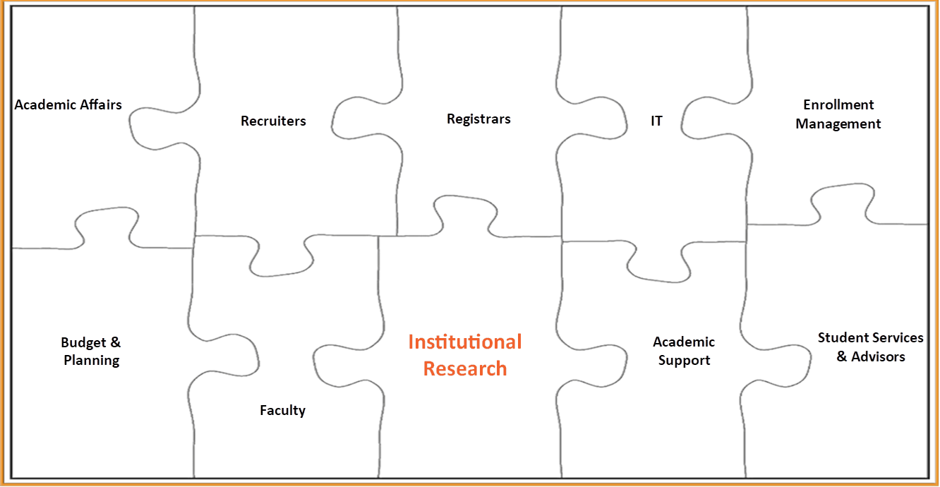
Working Together

Slide 5
Topics
SSPS Reporting Changes
Information Flow
Technical Guide
Incorporating Reporting Changes at Institutions
Next Major Topics to Tackle in Committee

