Slide 1
Moneyball: Using AI for Retention and enrollment projections
Dr. Steve Cox
Associate Vice Chancellor of IE and Planning
Central Louisiana Technical Community College
stephencox@cltcc.edu

Slide 2
Uses for AI (so far)
Enrollment Projections
Identifying At-Risk students
Forecasting class need

Slide 3
Caveats
There are a lot of caveats to these tools as I use them
I will acknowledge
using the statistics out of bounds
limited availability of statistical tools
use of mathematical principles applied to social problems is open for criticism
Please, feel free to improve

Slide 4
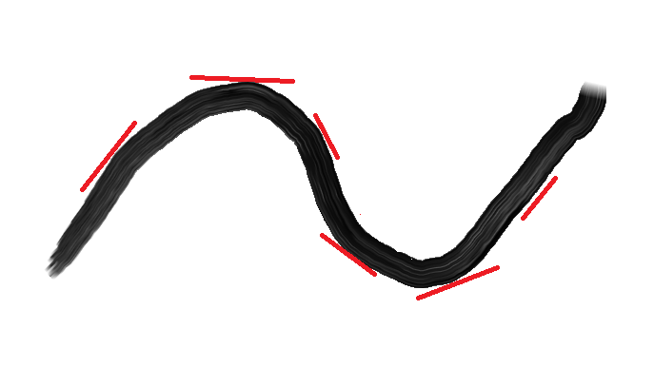
Aircraft Simulation Enrollment Projection
Based on limit theory
Use to predict what happens next
Increasing at Decreasing rate
Flat
Decreasing at increasing rate
Decreasing at Decreasing rate
Flat

Slide 5
Calculus class
Calculate the slope between 2 points (years) on the curve.
This is effectively the first differential
Calculate the slope between the slopes (the 2nd differential) to give you the rate of the rate

Slide 6
Enrollment Projections
Start with Regression
Y = mX + b
X is the year
Use Excel, Calculate the Slope, m
Calduate the Y intercept, b
Calculate the slope between points
Calculate the slope of slopes
Then, comes the fudge factor
Adjust the regression number up or down based on the 2nd derivative indicator (slope of slopes)
Adjust based on what you know – a program being added or dropped or other factors in the environment.

Slide 7
Enrollment Projection ChatGPT
Can you analyze the following data and make a prediction for each campcode for 2023:
campcode 2014 2015 2016 2017 2018 2019 2020 2021 2022
EA 381 426 356 356 449 450 492 425 427
EB 216 103 111 119 122 133 114 102 89
EE 35 59 58 74 117 122 116 120 129
EF 112 111 166 127 156 141 136 114 136
EG 158 152 150 128 144 137 109 109 113

Slide 8
Enrollment Projection ChatGPS
It is critical to write the phrase as follows:
Can you analyze the following data and make a prediction for each campcode for 2023:

Slide 9
Heads Results Fall 2023
Fall 2023 Heads Regular
Campus | Chat GPA Estimate | My Est | 14thday | ChatGPT | ME
EA | 410 | 427 | 416 | 1.46% | -2.58%
EB | 90 | 90 | 124 | 37.78% | 37.78%
EE | 140 | 120 | 100 | -28.57% | -16.67%
EF | 140 | 130 | 129 | -7.86% | -0.77%
EG | 130 | 110 | 115 | -11.54% | 4.55%
Total | 910 | 877 | 884 | -2.86% | 0.80%

Slide 10
SCH Results
Fall Regular Enrollment
Fall 2023 SCH regular | Chat GPA Estimate | Est | 14thday | ChatGPT | ME
EA | 5582 | 4990 | 4922 | -11.82% | -1.36%
EB | 931 | 1092.135 | 1550 | 66.49% | 41.92%
EE | 1579 | 1428.837 | 1188 | -24.76% | -16.86%
EF | 1588 | 1553.309 | 1610 | 1.39% | 3.65%
EG | 1214 | 1306.372 | 1354 | 11.53% | 3.65%
Total | 10894 | 10370.65 | 10624 | -2.48% | 2.44%

Slide 11
Summer – We were both terrible predicting heads
campcode | My Est | ChatGPT | 14thday | Me | ChatGPT
EA | 140 | 139 | 143 | 2.14% | 2.88%
EB | 60 | 60 | 76 | 26.67% | 26.67%
EE | 60 | 51 | 61 | 1.67% | 19.61%
EF | 40 | 39 | 58 | 45.00% | 48.72%
EG | 70 | 81 | 72 | 2.86% | -11.11%
 | 370 | 370 | 410 | 10.81% | 10.81%

Slide 12
Summer SCH
campcode | My Est | ChatGPT | 14thday | Me | ChatGPT
EA | 987 | 1091 | 832 | -15.70% | -23.74%
EB | 383 | 411 | 494 | 28.98% | 20.19%
EE | 374 | 481 | 376 | 0.53% | -21.83%
EF | 244 | 253 | 305 | 25.00% | 20.55%
EG | 445 | 661 | 420 | -5.62% | -36.46%
Total | 2433 | 2897 | 2427 | -0.25% | -16.22%

Slide 13
Identifying At-Risk students
Use a free tool, KNIME. (www.knime.com)

Slide 14
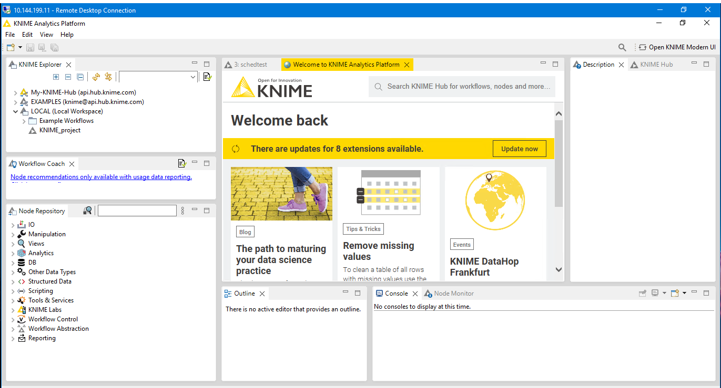

Slide 15
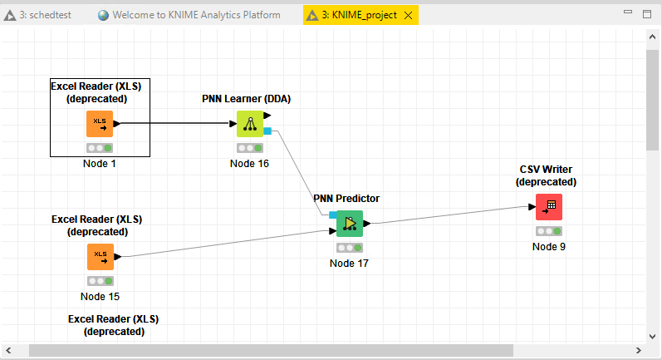

Slide 16
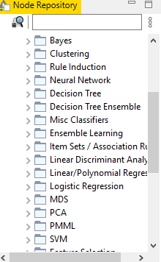
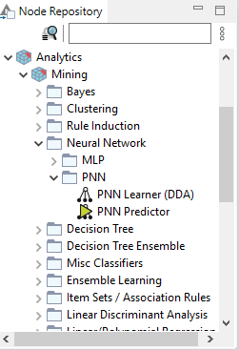

Slide 17
Rules
The At Risk list must be compiled quickly after Census Day
It is easy to identify who is At Risk at the end of the term
The problem is to identify who is At Risk quickly in the term
For those identified as At Risk, then there must be outreach

Slide 18
Training Model
Choose variables for FT FTFY DS students
The following variables were used in the initial model. They were chosen as being possibly related to retention.
Student ID, GPA,ACT High School Code, Student’s zip code,Gender, Program,Campus, BOR Ethnicity Code, age, parish, GradREt – (1 for returning or completed in a year, 0 for not returning not completing), retype – (1 for training data, 2 for learning data), EFC, Late enrollment.
As the model goes through iterations, several of these variables were eliminated. Or the way the data was presented was modified.
Calculate the average of those in previous years that have either been retained or completed. Keep 1 year back so you have a test year. You want all data to be in percentage form. Some data, such as EFC, late enrollment data, and GPA were converted into zones.

Slide 19
Creating data
Go Back 5 years
Calculate the percentage of retention/completion for each category
Using Excel, Using the Data Analysis Tool, Regression, I run each column against graduation retention for each individual
If the Sum of Squares is above a certain value, for example, Program is .078 and age is .02. I will use Program, but probably disregard age is it has minimal influence. Parish has a stronger influence, and gender has almost no influence

Slide 20
SUMMARY OUTPUT
Regression Statistics
Multiple R | 0.280577
R Square | 0.078723
Adjusted R Square | 0.078409
Standard Error | 0.119366
Observations | 2930
ANOVA
 | df | SS | MS | F | Significance F
Regression | 1 | 3.564875 | 3.564875 | 250.1984 | 3.85387E-54
Residual | 2928 | 41.7187 | 0.014248
Total | 2929 | 45.28358
 | Coefficients | Standard Error | t Stat | P-value | Lower 95% | Upper 95% | Lower 95.0% | Upper 95.0%
Intercept | 0.677325 | 0.004271 | 158.5779 | 0 | 0.668950043 | 0.6857 | 0.66895 | 0.685699934
gradret | 0.078888 | 0.004987 | 15.81766 | 3.85E-54 | 0.069109165 | 0.088667 | 0.069109 | 0.088667306

Slide 21
Influence
Program
Parish
Stratified EFC 0, 0-2000
Late enrollment (after Aug 1)

Slide 22
Setting Up Stats
A MAnova would probably be a better choice of statistical products

Slide 23
Results
row ID | programper | parishper | laterate | hsbgiper | zipper | P (gradret=0) | P (gradret=1) | Prediction (gradret)
1 | 0.867117 | 0.5 | 0.760618 | 1 | 0 | 0.9989602823569605 | 0.00104 | 0
2 | 0.764706 | 0.658774 | 0.760618 | 0.7375 | 0.583333 | 0.33741775263919904 | 0.662582 | 1
3 | 0.791461 | 0.658774 | 0.760618 | 0.7375 | 0.659091 | 0.1503794488984141 | 0.849621 | 1
4 | 0.791461 | 0.765957 | 0.760618 | 0.775281 | 0.76259 | 0.11587764572206506 | 0.884122 | 1
5 | 0.941176 | 0.857143 | 0.760618 | 0.7375 | 1 | 0.003826 | 0.9961741583843192 | 1
6 | 0.941176 | 1 | 0.760618 | 0.7375 | 1 | 0.002631 | 0.9973693123985368 | 1
7 | 0.867117 | 1 | 0.760618 | 0.7375 | 1 | 0.00215 | 0.9978504264986479 | 1
8 | 0.867117 | 1 | 0.760618 | 0.7375 | 1 | 0.00215 | 0.9978504264986479 | 1

Slide 24
Rules 2
If the return predictions are low in returning – the bottom 25% out our college, then we do a call out. Instructors reach out to the students early in the semester
These students may have needs that need to be met
For those students with high percentages, don’t waste your resources doing a call out.

Slide 25
Problems
This model’s effective is above 60% and less than 70% accurate in any given year
High School grads have these tendencies
They expect to do the same as they do in high school.
Students that do about the same as they did in high school, tend to return
A B student in high school, who is a B student at your college, will likely return next year.
Students who do better than they did in high school, tend to transfer out
A B student in high school, who is an A student at your college, will tend to try another college next year. This model struggles to predict these students
Students who did poorer than in high school, tend to transfer out

Slide 26
Schedule Data
termcode,course,heads
201920,ACCT1100EB,2
201920,ACCT1100EG,36
201920,ACCT1200EA,8

Slide 27
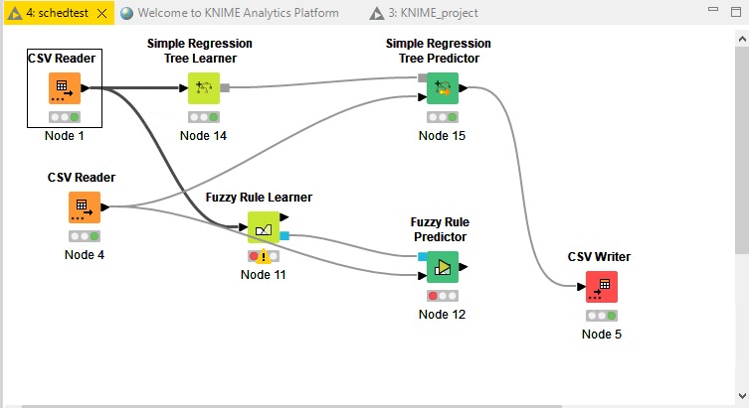
KNIME Schedule (Simple Regression Predictor)

Slide 28
Schedule Prediction
"ï»¿termcode","course","heads","Prediction (heads)"
202520,"ACCT1100EB",0,2
202520,"ACCT1100EG",0,32.75
202520,"ACCT1100EN",0,40.25
202520,"ACCT1100EZ",0,24
202520,"ACCT1200EA",0,8

