Slide 1
Panel: Preparing for SACSCOC 5th Year Submission
Margaret McMichael, River Parishes
Bill Tulak, LCTCS System
Renee Hicks, Nichols State
Charles Miller, South Louisiana
Steve Cox, Central Louisiana

Slide 2
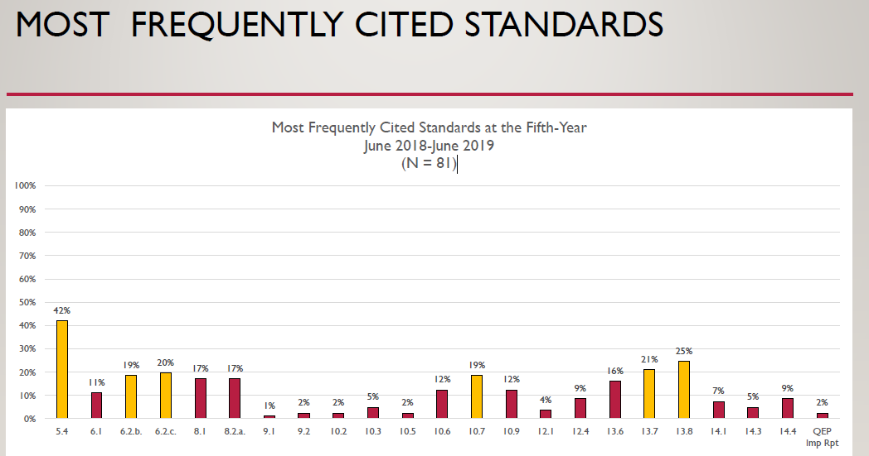

Slide 3
Section 6 Faculty
The institution employs an adequate number of full-time faculty members to support the mission and goals of the institution.
For each of its educational program, the institution
  Justifies and documents the qualifications of its faculty members
  Employs a sufficient number of full-time faculty members to ensure curriculum and program quality, integrity, and review.
  Assigns appropriate responsibility for program coordination
The institution publishes and implements policies regarding the appointment, employment, and regular evaluation of faculty members, regardless of contract or tenure status

Slide 4
Section 6 Faculty
The institution publishes and implements appropriate policies and procedures for preserving and protecting academic freedom.
The institution provides ongoing professional development opportunities for faculty members as teachers, scholars, and practitioners, consistent with the institutional mission.

Slide 5
Section 8: Student Achievement
The institution identifies, evaluates, and publishes goals and outcomes for student achievement appropriate to the institution’s mission, the nature of the students it servers, and the kinds of programs offered. The institution uses multiple measures to document student success.
The institution identifies expected outcomes, assess the extent to which it achieves these outcomes, and provides evidence of seeking improvement based on analysis of the results below:
  Student learning outcomes for each of its educational programs.
  Student learning outcomes of its undergraduate degree programs
  Academic and student services that support student success.

